Slide 1


Notes:
Introductions, name, position etc. z

Slide 2
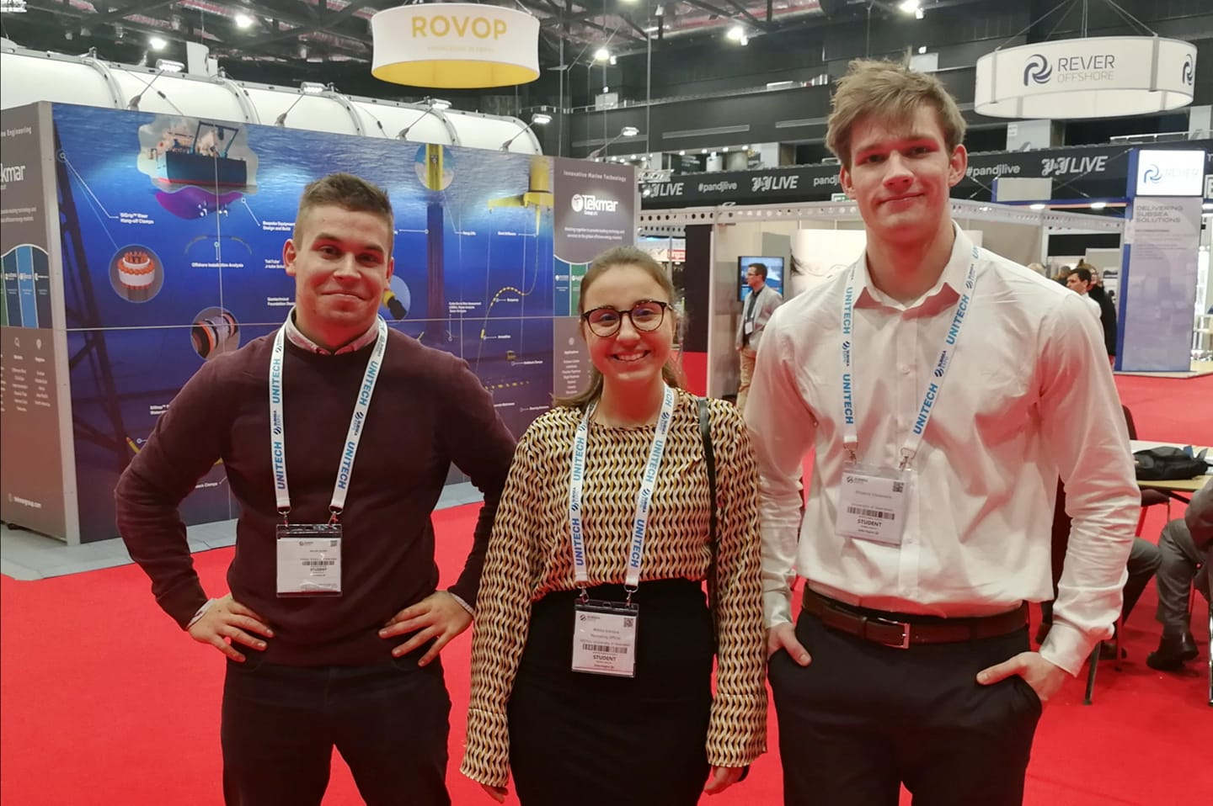
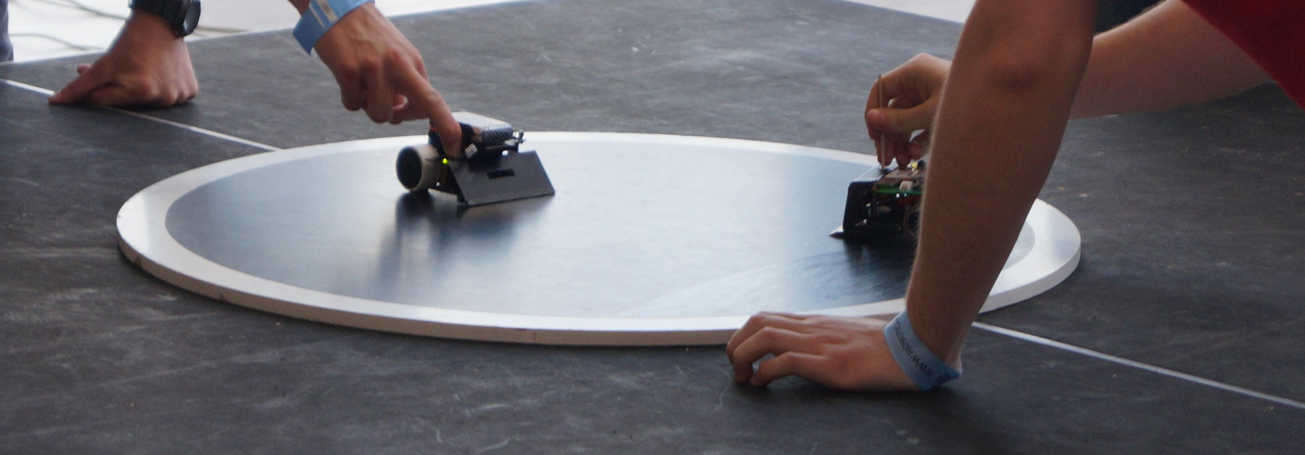
Hello World!
Some projects we have been involved in:
  MATE ROV competition
  Robot sumo
  This year – ROBOTICS LEAGUE!!!
Affiliations with the IET and IEEE
Participation in university open days
Connections with the Uni
Socials in collaboration with other engineering societies
Notes:
Petar’s slide

Slide 3
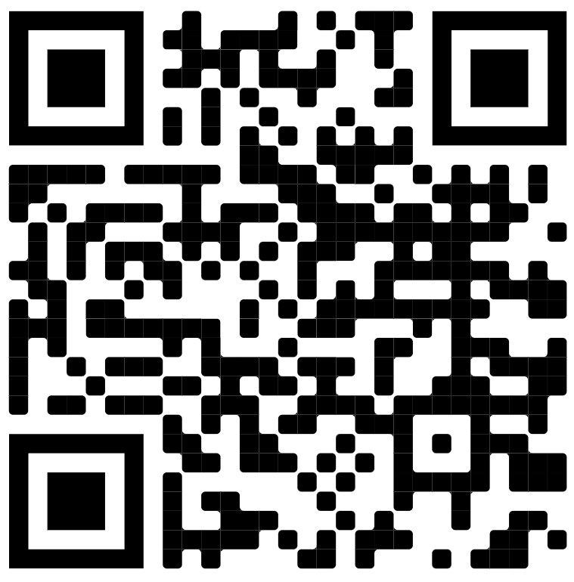
Joining the Society
Weekly sessions are on Wednesdays 4pm to 6pm at MR303
Short briefing
Guidance and help with any problems you’re having
Memberships are required!
Follow us on Facebook! EEESoc Aberdeen
Get your membership here! →
Notes:
Aleks’ slide

Slide 4
Robotics League
Mock competition: Week beginning 28th November
Final competition: Week beginning 27th March
Split into teams of 2-4 people
Kit will be given out at the next session
REQUIREMENTS:
  Laptop (if you have one)
  Arduino IDE (or alternatives like VS code)
  Ability to google
Notes:
Austeja

Slide 5
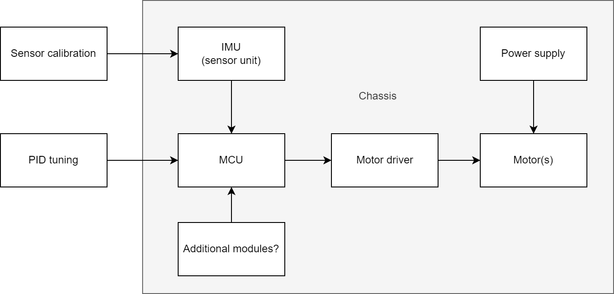
The Self Balancing Robot – module break down
Notes:
KJ

Slide 6


The Competition!
  Three main disciplines:
    Speed
    Balance
    Obstacles
  There will be dividends!
Notes:
All in unison

Slide 7
Q & A!
Notes:
Dead silence

